Slide 2
Network Attacks - DNS
Retransmission of data

Slide 3

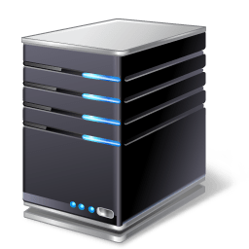



DNS Process
www.google.com
DNS Server
DNS Zone
DNS Cache
DNS Cache

Slide 4
DNS Process
DNS Server
Root DNS Server
com DNS Server
Google DNS Server
DNS Cache

Slide 5

DNS Process
DNS Server
Root DNS Server
com DNS Server
Google is at xxx.xxx.xxx.xxx
Google DNS Server
DNS Cache

Slide 6
DNS Process
www.google.com
DNS Server
Google is at xxx.xxx.xxx.xxx
DNS Cache
DNS Cache

Slide 7


DNS Poisoning
DNS Server
Root DNS Server
com DNS Server
www.google.com xxx.xxx.xxx.xxx
Google DNS Server
DNS Cache

Slide 8
DNS Poisoning
www.google.com
DNS Server
Google is at xxx.xxx.xxx.xxx
DNS Cache
DNS Cache

Slide 9

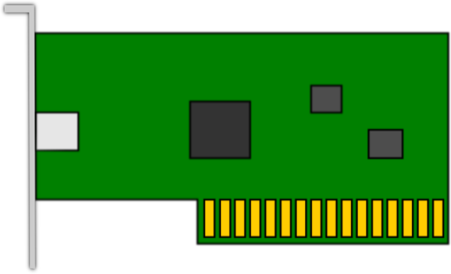
DNS Hijacking
www.google.com
Malicious DNS Server
Malicious Web Server

Slide 10
Domain Hijacking
ser
https://lookup.icann.org/lookup
ITPro.TV
Attacker’s Control

